Slide 1

COMMUNITY DEVELOPMENT NEWSLETTER 2021
We are slowly merging out of our third lockdown; however, this will not stop us from thinking creatively about how we can still reach out to the communities and still deliver such vital work through this pandemic. We are working in partnership with The Rank Foundation to reach out to minority ethnic groups and research what we can do to support this area of work. We have a new project ‘Community in Action’ which will be led by our Time to Shine Leader. We have a third-year student placement to support our delivery of work from DMU and a project manager to link in the business members with the community to ensure the vision is delivered. This is an exciting time but also a challenging one but again through sheer determination and working together anything is possible.
At Leicestershire Cares the Community Development Team decided to spread a little hope and cheer in these difficult times, by running a ‘bags of hope’ campaign to our old and new community partners to reach out to more of the ones that have been left behind.

Slide 2
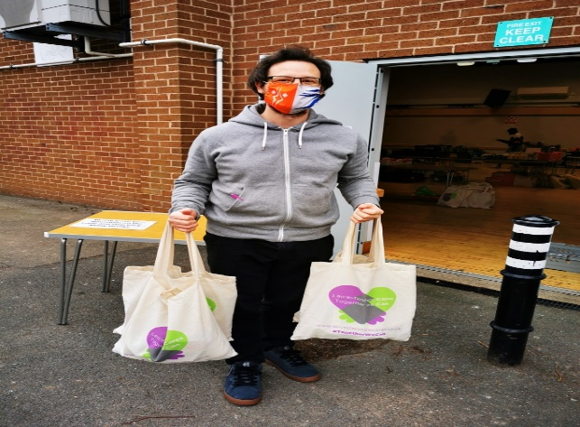
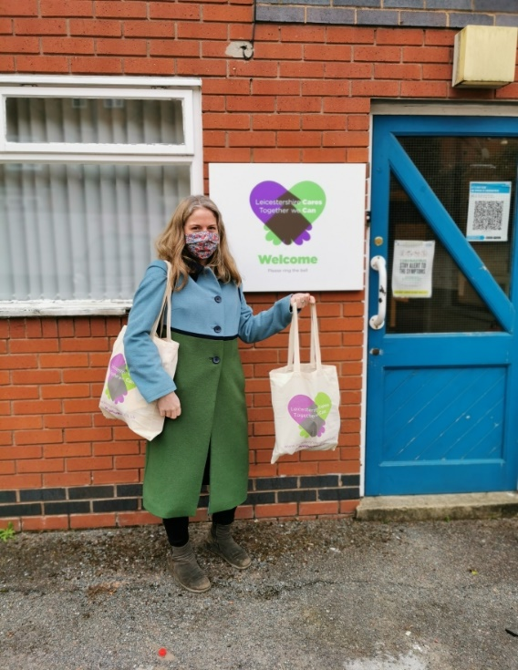
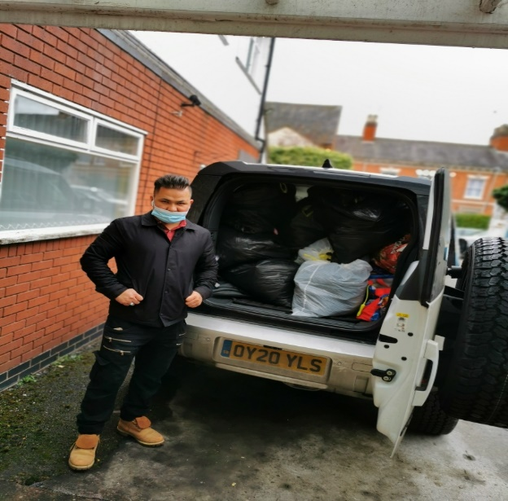
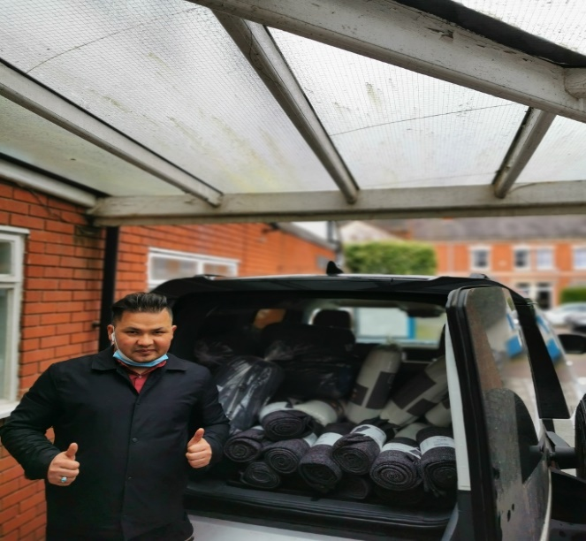
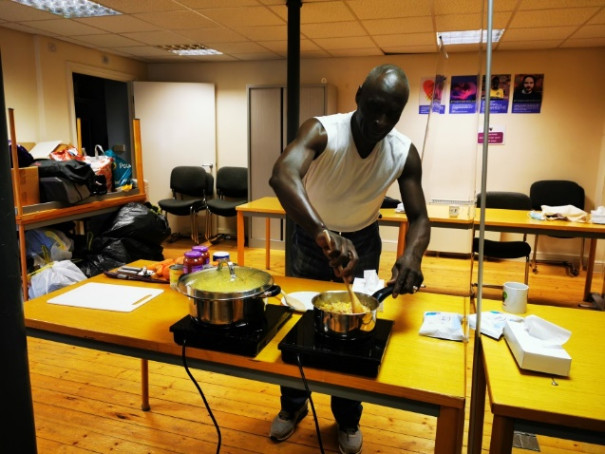
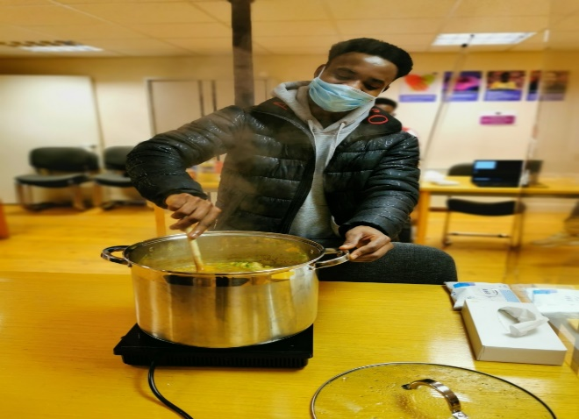
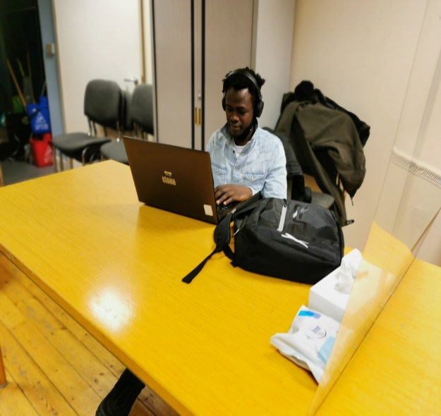
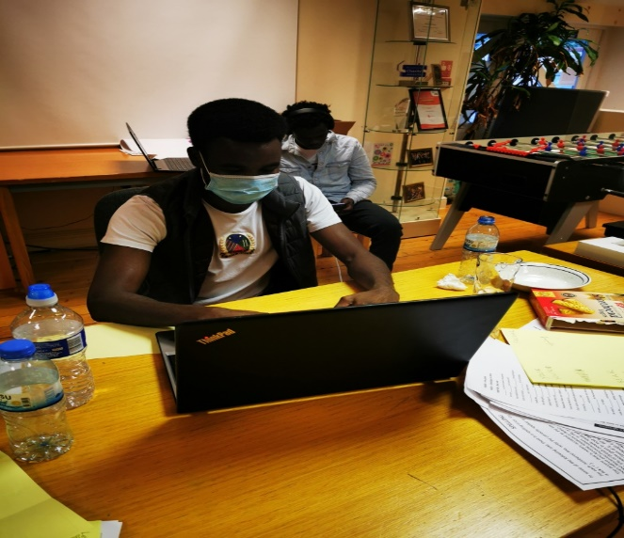
Working in the Braunstone area, specifically at the Braunstone Civic Centre to deliver our ‘together we care’ bags. And Councillor Melissa March providing bags to distribute to her local elderly homes to bring some hope and cheer.
Partnership Working with Redcross. Leicestershire Cares donated bags of women, and children’s clothing, toys and books. RedCross also kindly donated pillows and blankets to our Asylum and Refugee participants who reside in bedsits and hostel accommodation.
We have recently recruited a volunteer from the WIRE Project which supports ex offenders, who wants to give back to the community and is currently supporting our Ayslum and Refugee participants.
Because of the impact of the lockdown and children were having to be home schooled we found that many participants didn’t have access to WIFI, a printer and general support. The Asylum and Refugees we work with were very alone, isolated and their mental health increased due to lack of support and facilities to enable them to continue their studies and keep on top of their work. We decided to run a Homework Club once a week to ensure they had a safe place to attend and have access to facilities and equipment they ordinarily would not have had.

Slide 3
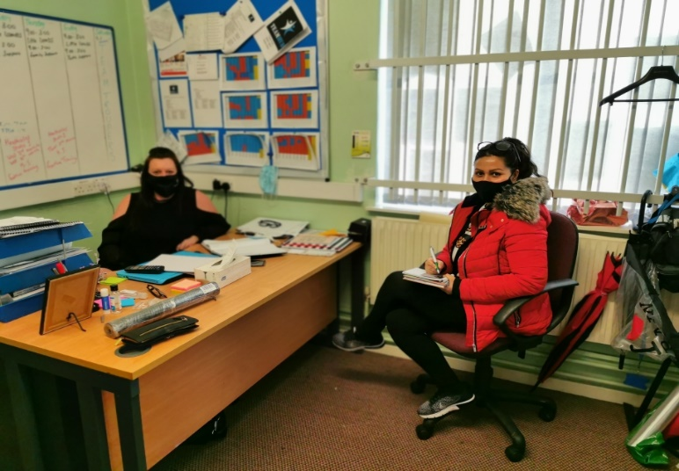
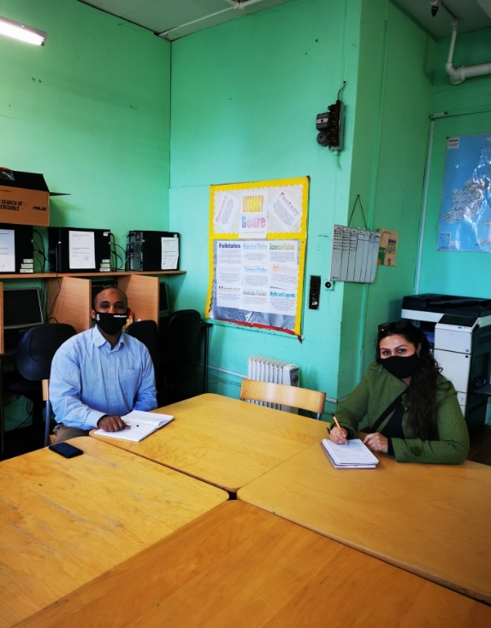
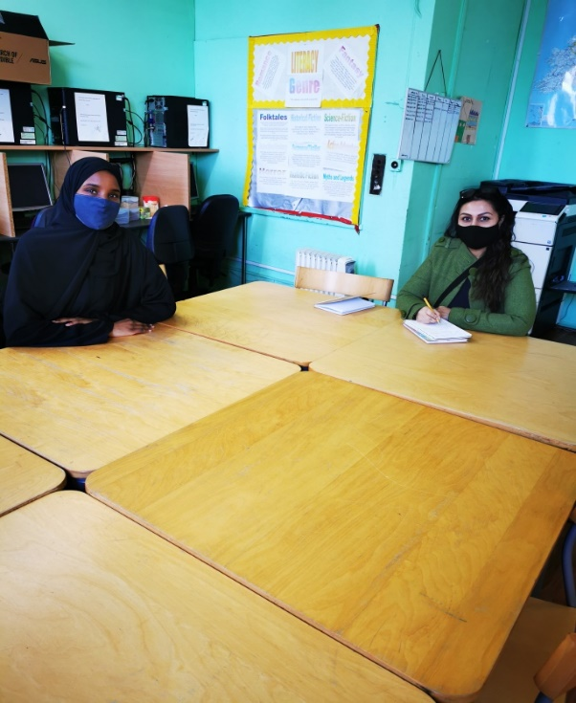
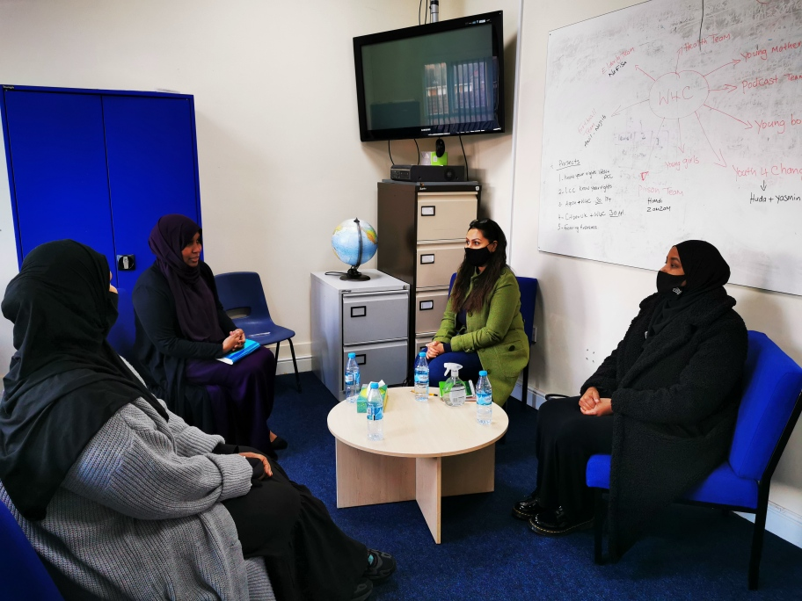
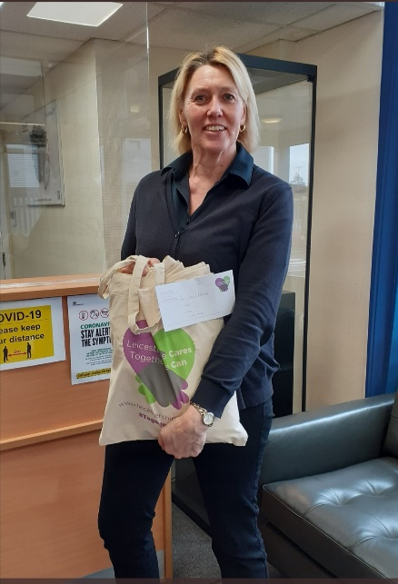
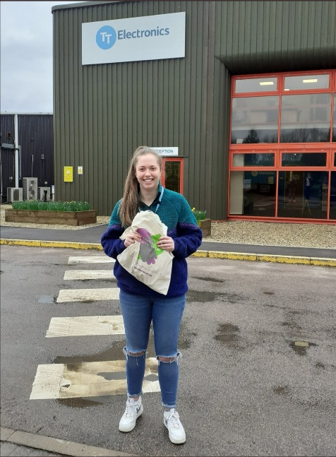
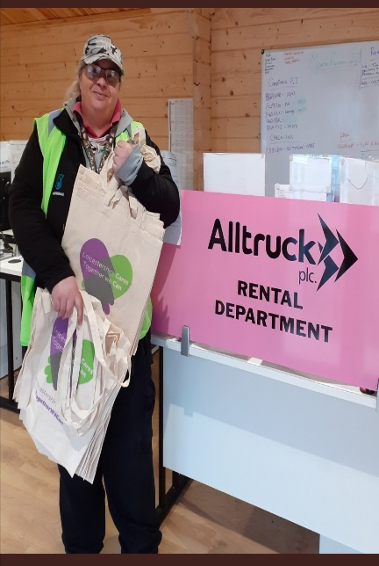
A great meeting with Jo Randell who manages the New Parks Community Hub. This community centre is open 5 days a week and run’s several free sessions to support disadvantaged families and children. Leicestershire Cares is excited to work in partnership with Jo to enhance the delivery of work and support to the community.
Another partnership meeting took place at St Matthews Somali Community Parents Association. We are discussing what support we can provide to this centre using our business members and other projects within Leicestershire Cares. This is all about cross collaboration.
Another group who run their services voluntarily in St Mathews is a all women group named Women 4 Change. These women like to inspire and instil confidence in other women, empowering them to be who they want to be and reach out when they need help. Again Leicestershire Cares will be working along side this organisation to enhance the work that they are already delivering and creating new opportunities for the community.
Our empty Leicestershire Cares ‘bags of hope’ have been distributed to our business members to support our communities within Leicester and Leicestershire. We cannot thank you enough as without your ongoing support for Leicestershire Cares it would not be possible to reach out to as many communities as we do…..THANK YOU!

Slide 4
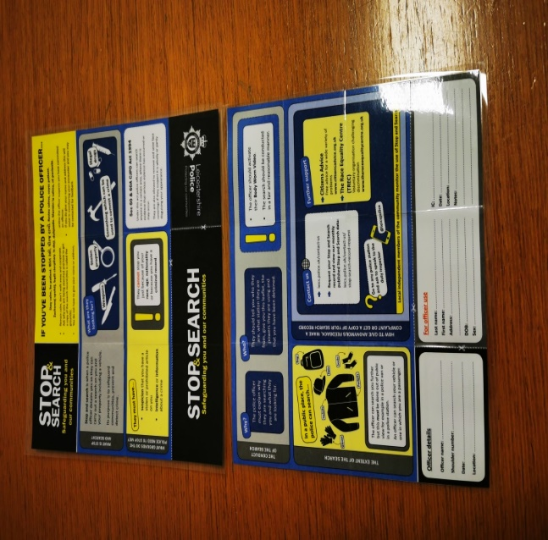
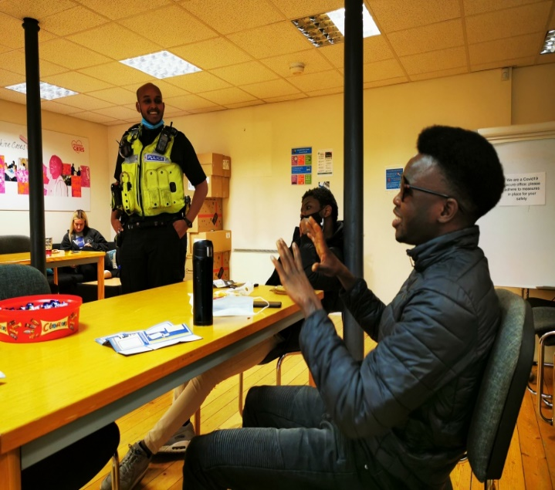
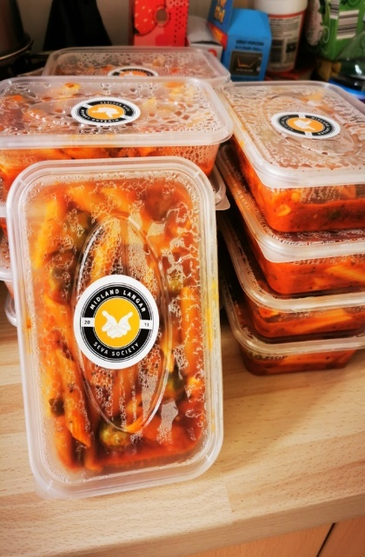
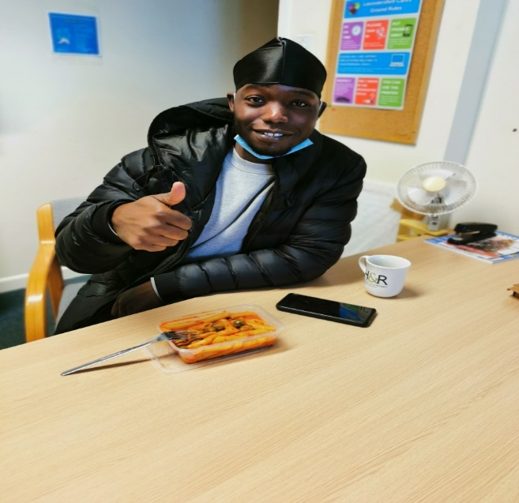
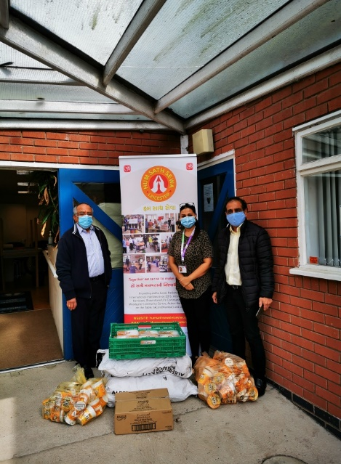
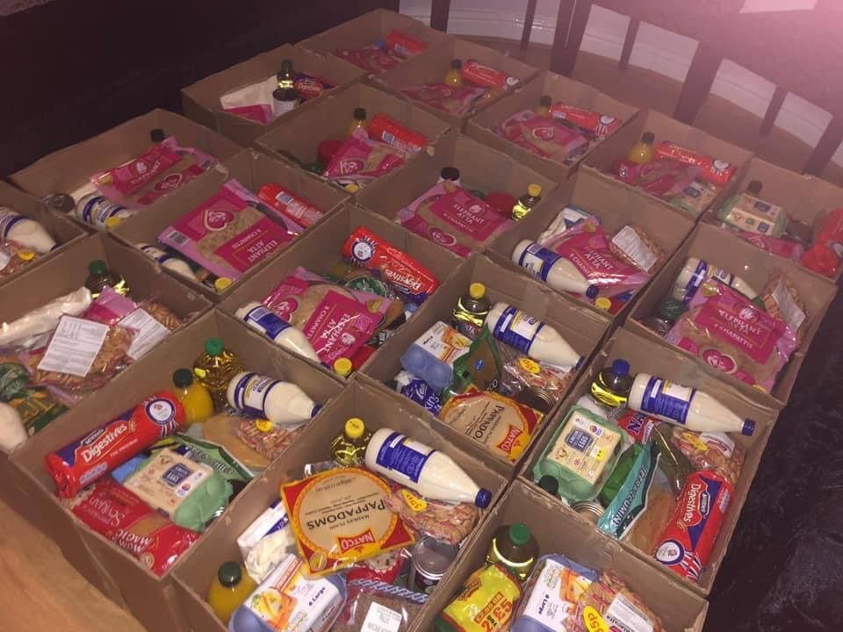
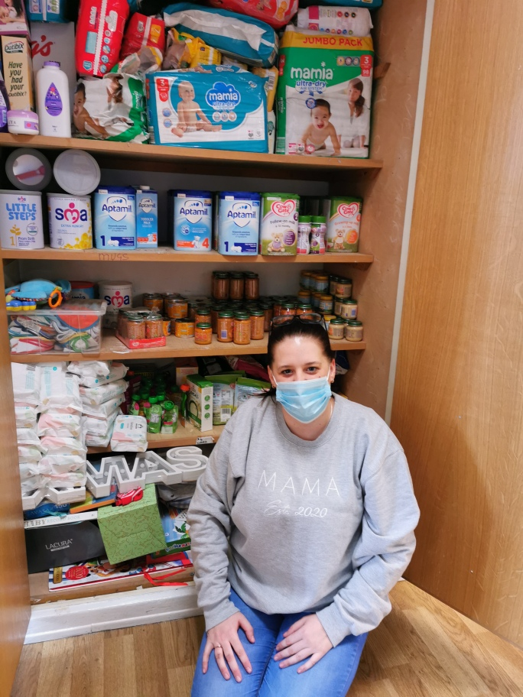
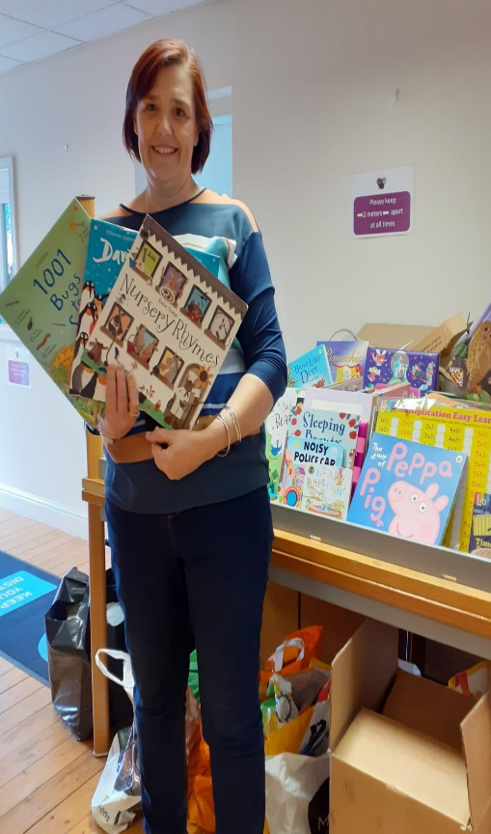
We delivered a Stop and Search, know your rights session. Thank you to Constable Adam Ahmed for taking time to explain what this means to our Asylum and Refugee participants. It was a real eye opener on the dos and don'ts of the law and the implications of mindsets and attitudes towards the UK law and the police.
Thank you to the Midlands Sewa Langar for donating some food to our Leicestershire Cares participants, to ensure nobody is left behind and Hum Sath Sewa Team for delivering it to us. A new partnership that will develop and further our work in the community.
Together we are stronger!
The Community Development Team at Leicestershire Cares donated £200 to a project named ‘outspoken’ which deliver hot food and food parcels to the minority ethnic community that are struggling with loneliness and isolation. They also have a food bank that people can readily access. Great charity to support the work they are delivering in hard to reach areas.
In New Parks Team Hub we set up its very first ‘baby food bank’ working in partnership with Hun Sath Sewa team from Belgrave, and within 3 weeks we made this happen by contributing nappies, wipes, food, baby milk, and baby bibs.
Also in New Parks Team Hub we developed a new little children’s library for the community in honour of world book day, and a scheme to ‘reduce, reuse, recycle’ books. This has been so popular we are now reaching out wider to get more mini libraries set up in other communities and get the books replenished. Thank you to our business members who have supported and donated.

Slide 5
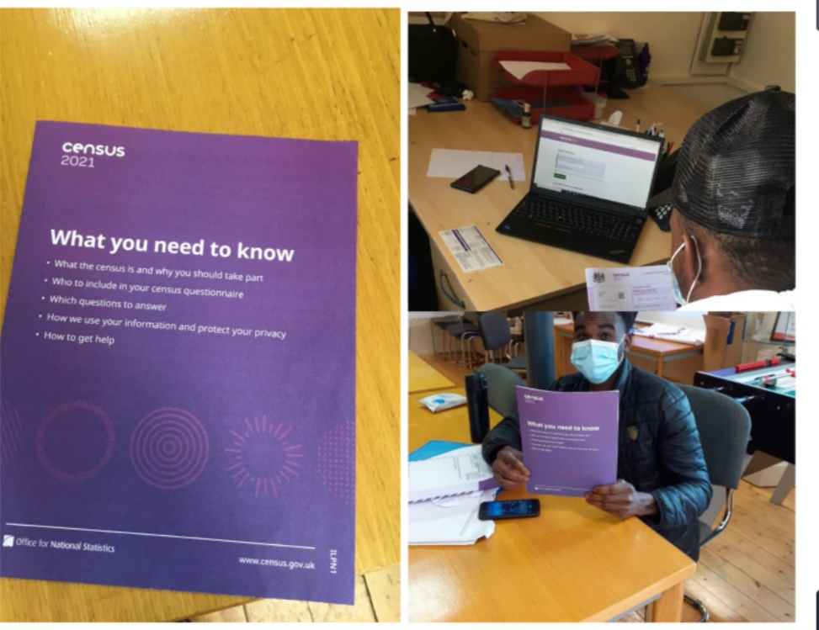
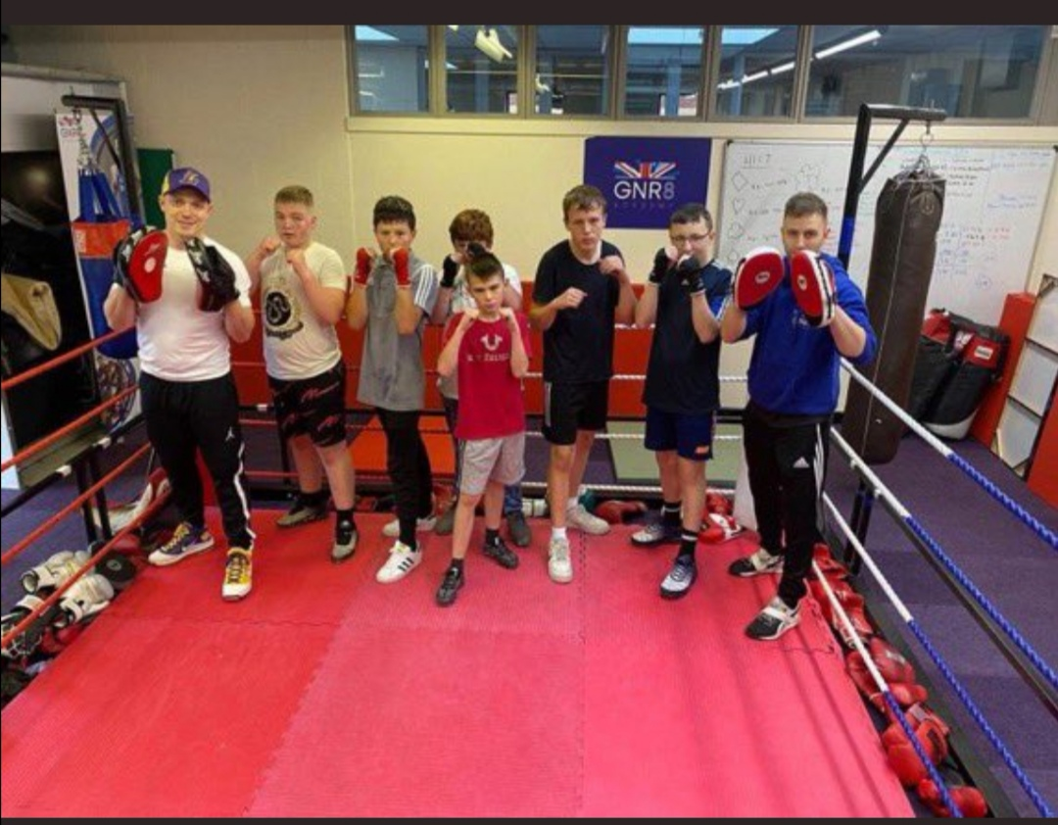
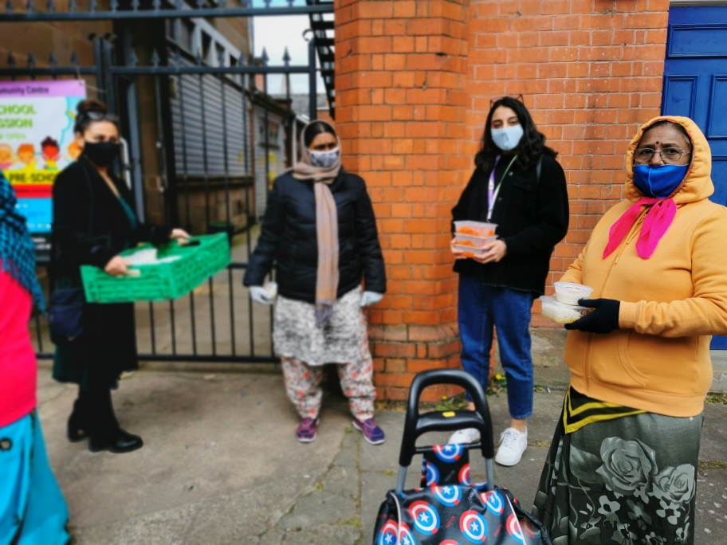
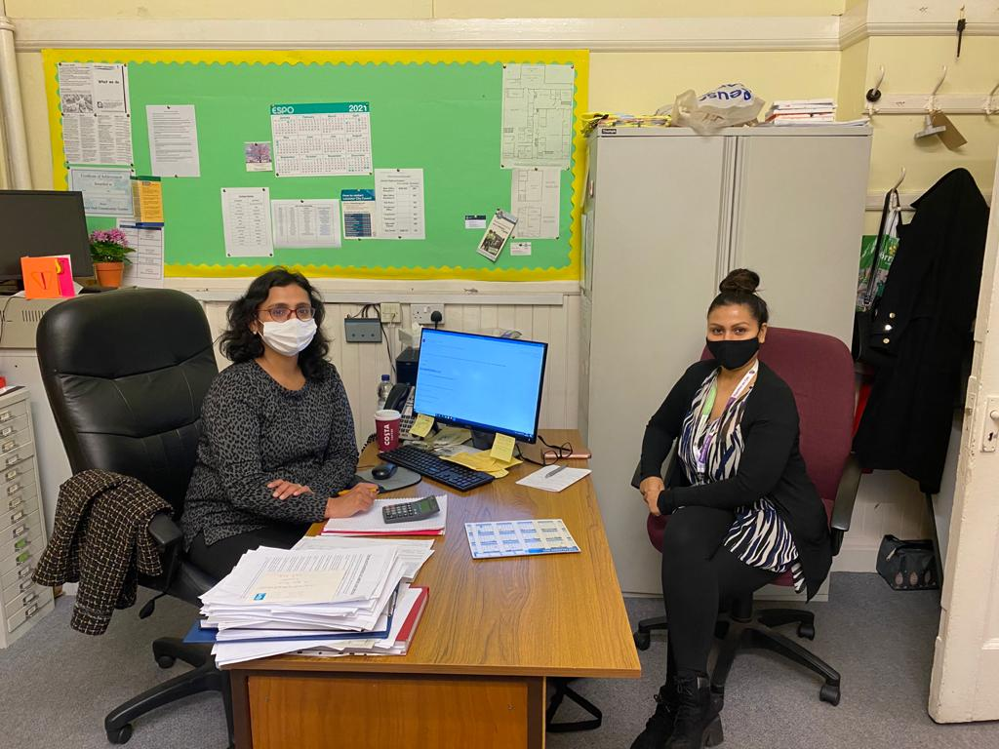
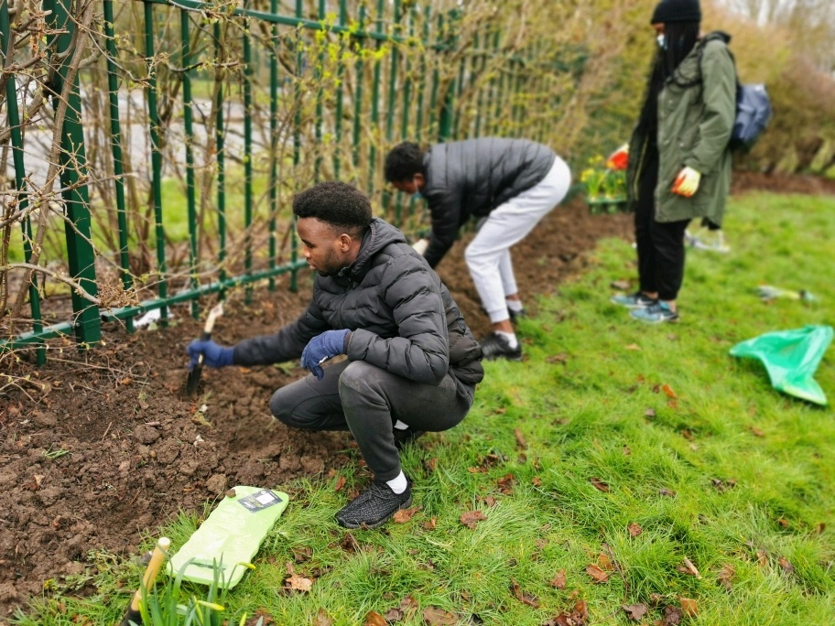
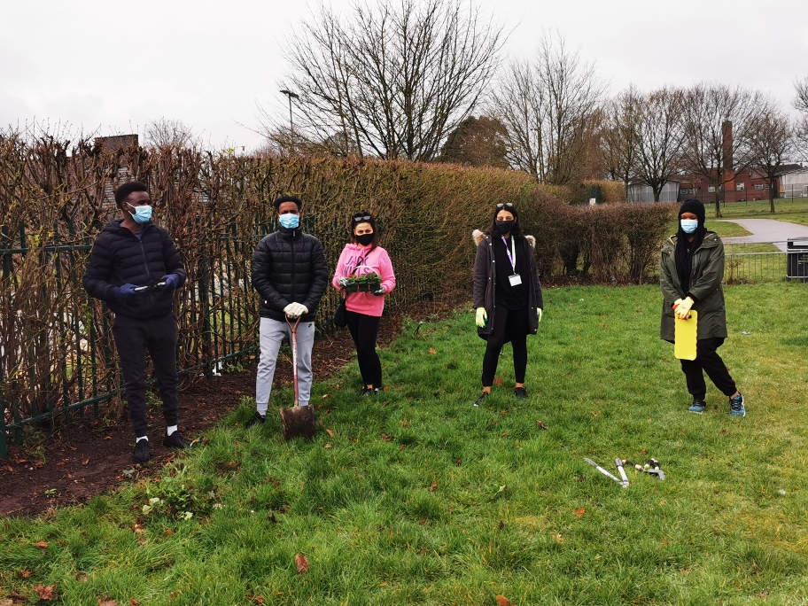
Supporting our Asylum and Refugee participants with completing their census forms to have a wider understanding on why this form is so important to complete.
The Team Hub in New Parks have a high percentage of children not in education, employment or training, so at the GNR8 Academy we teamed up to see what Community Development Team could do in supporting this and funded a 6 week programme in their Boxing Academy. This programme will support up to 25 participants.
Delivering hot food to Wesley Hall food bank in Highfields/spinney hill area. 270 people queue three times a week for food here and it is a honour for the community development team to work in partnership to support this much needed community. We have also funded for the community to have weekly session via zoom on Fitness, Yoga, Mehndi, Happiness and Mindfulness with 30/40 participants taking part each week.
Working in collaboration with the Yes Project we delivered a mini Team Challenge outdoors to an outreach community centre for children and families to make the entrance to their door more welcoming and nicer to look at.

Slide 6
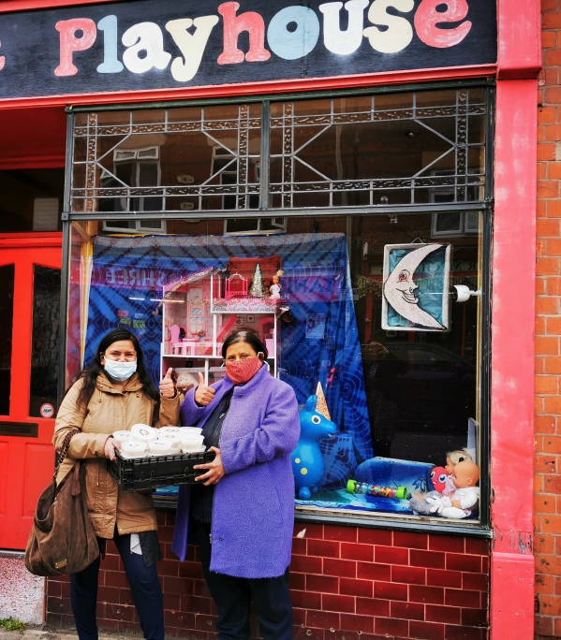
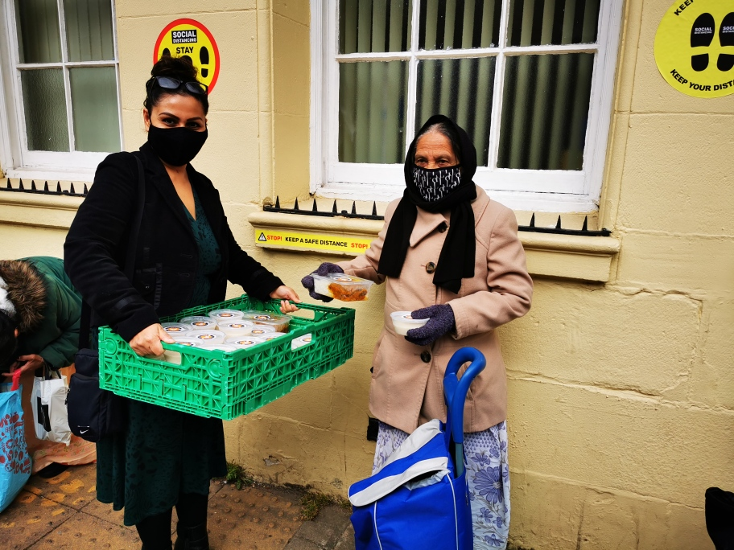
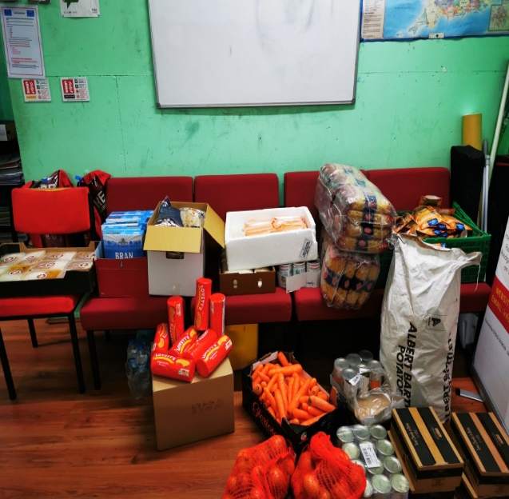
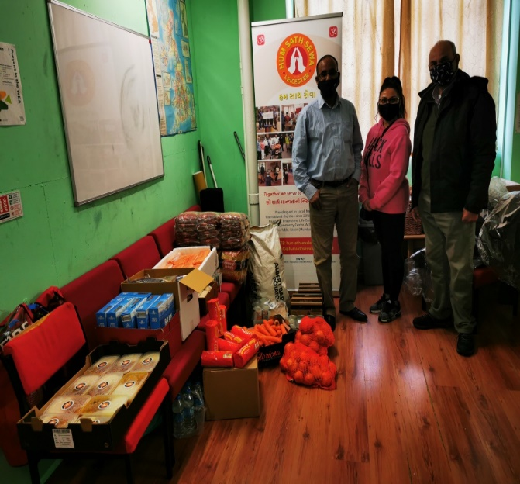
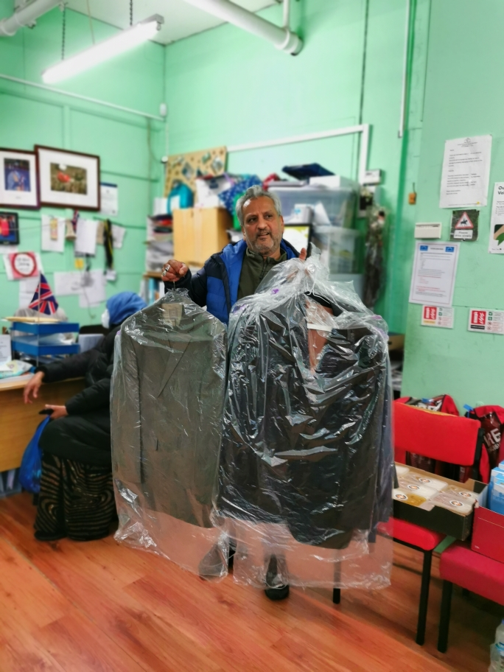
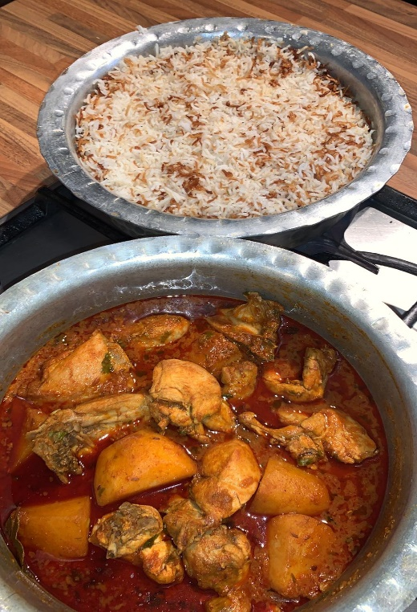
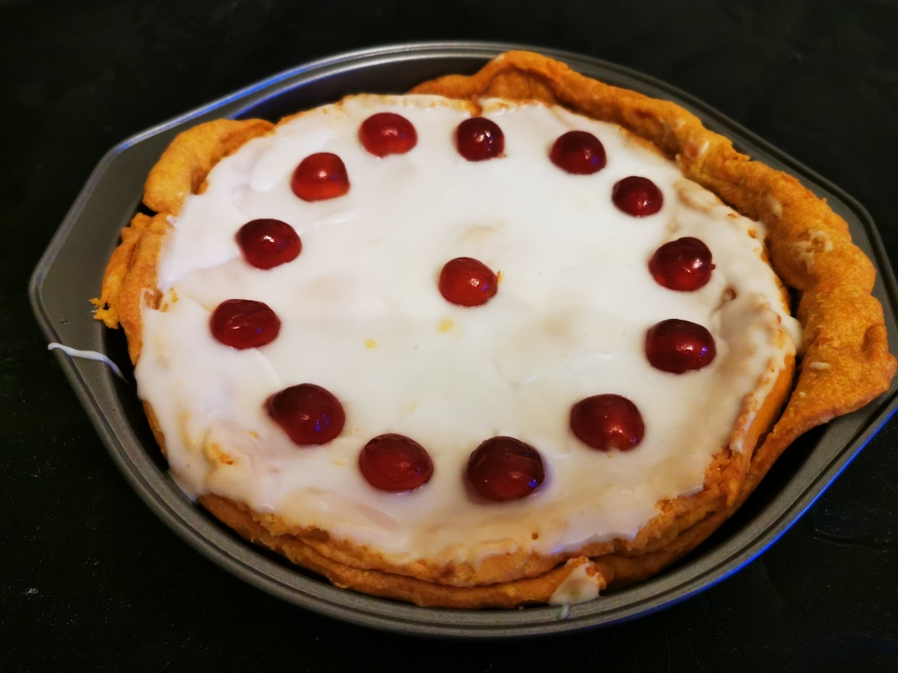
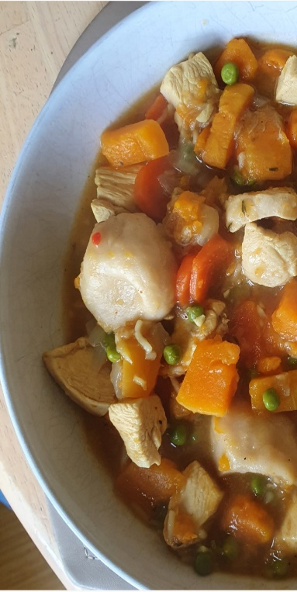
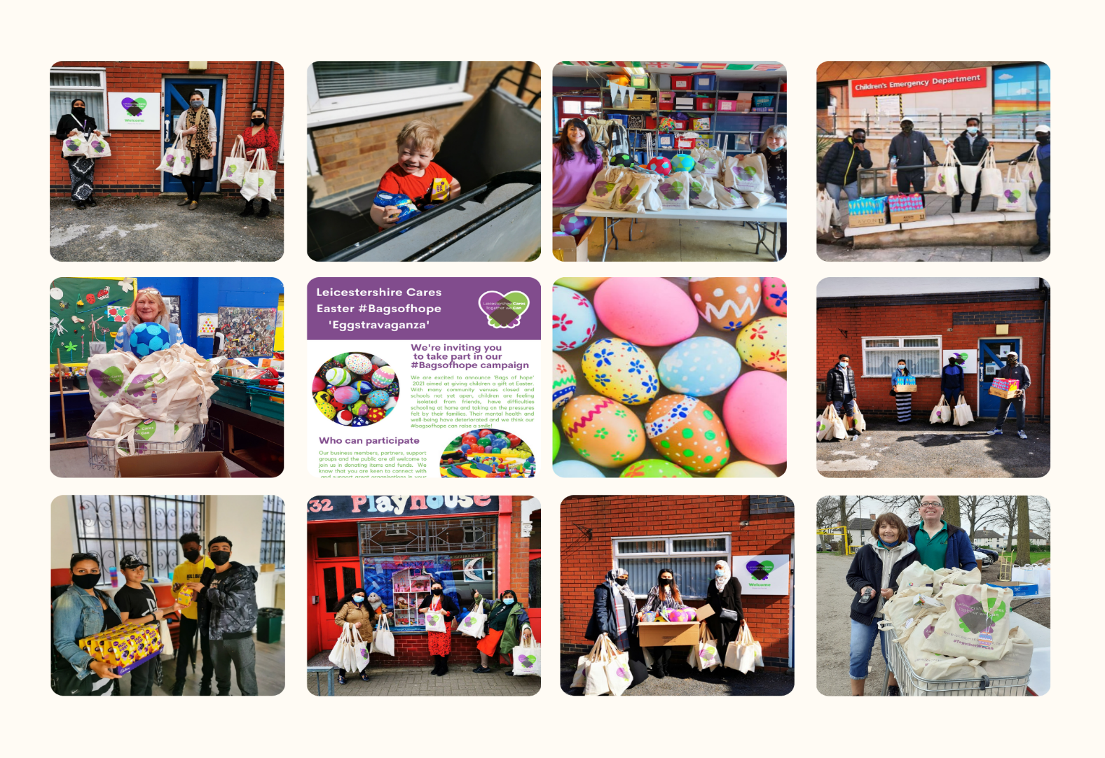
In the Sikh Community there is a huge celebration each year on Visaiaki so in honour of this we distributed 100 Kheer (rice pudding) to the communities food banks and house holds who were celebrating.
The CD Team were the broker between the Somali Community and the Hindu Community to work together to deliver a food bank once a week to the community in St Matthews. To see different faith groups come together and break down any stigma and barriers was just wonderful to unite and show when we work together look what we can achieve together!
Quarantine Cooks, since last year March 2020 is still going strong. We have been continuing our zoom sessions fortnightly teaching healthy nutritional meals for £10.00 and under which LC funded by providing Aldi vouchers to our participants to enable anyone that wanted to take part could do without any barriers or restrictions to buy the ingredients and also empowering them to come up with their own ideas on what they wanted to cook taught by a professional chef.
Here is a collage of all the #bagsofhope we all worked on through Easter and in total we had 723 bags and chocolates delivered to 25 different communities in Leicester and Leicestershire. This is quite extraordinary and the impact of these bags given were very well received.
THANK YOU TO EVERYONE INVOLVED!

Slide 7
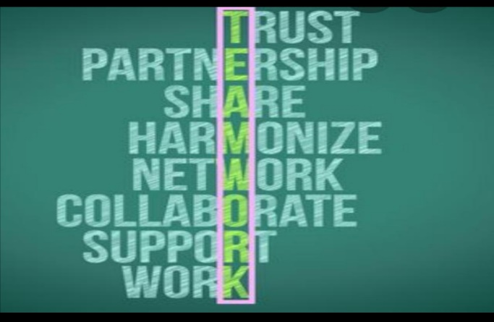
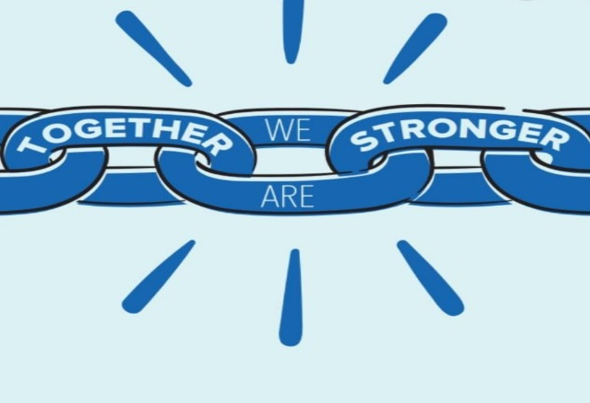
If you would like to get involved or contribute to any of the Community Development work at Leicestershire Cares, please get in touch.
Email: communitydevelopment@leicestershirecares.co.uk Or Neetu@leicestershirecares.co.uk
Office No: 0116 4645215
Mobile: 07834181041

